Slide 1
Mettre en place une gouvernance pour la Power Platform, Power BI, Power Apps et Microsoft Flow
Franck Mercier et Nicolas Georgeault
TSP Microsoft et Founder @Mubrain
Reseau: BanQ Evenement
Usager: 45166354
MDP: 680629

Slide 3
Agenda
Pourquoi une gouvernance?
Particularité de la Power Platform de Microsoft
L’éducation, le point clé de la gouvernance
Microsoft PowerApps
Microsoft Flow
Power BI
Conclusion

Slide 4
Pourquoi?
Notes:
3mn

Slide 5

Notes:
S’engager à délivrer un service c’est signer un contrat d’engagement avec votre client

Slide 6
Nouveau?

Slide 7
Rien ne se perd, rien ne se créé, tout se transforme
«
»
Antoine Lavoisier
Anaxagore
Notes:
Ceci s’est déjà produit par le passé…
Chiffriers Excel devenus très sensibles
Bases de données Access critiques

Slide 8
La Power Platform
Notes:
10mn

Slide 9

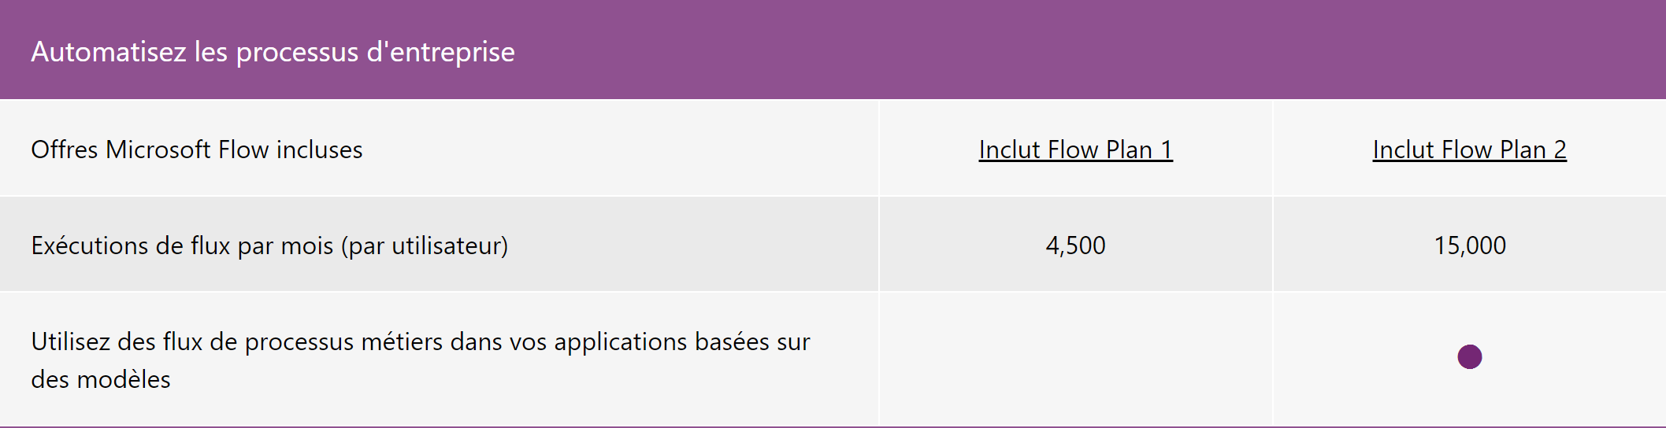


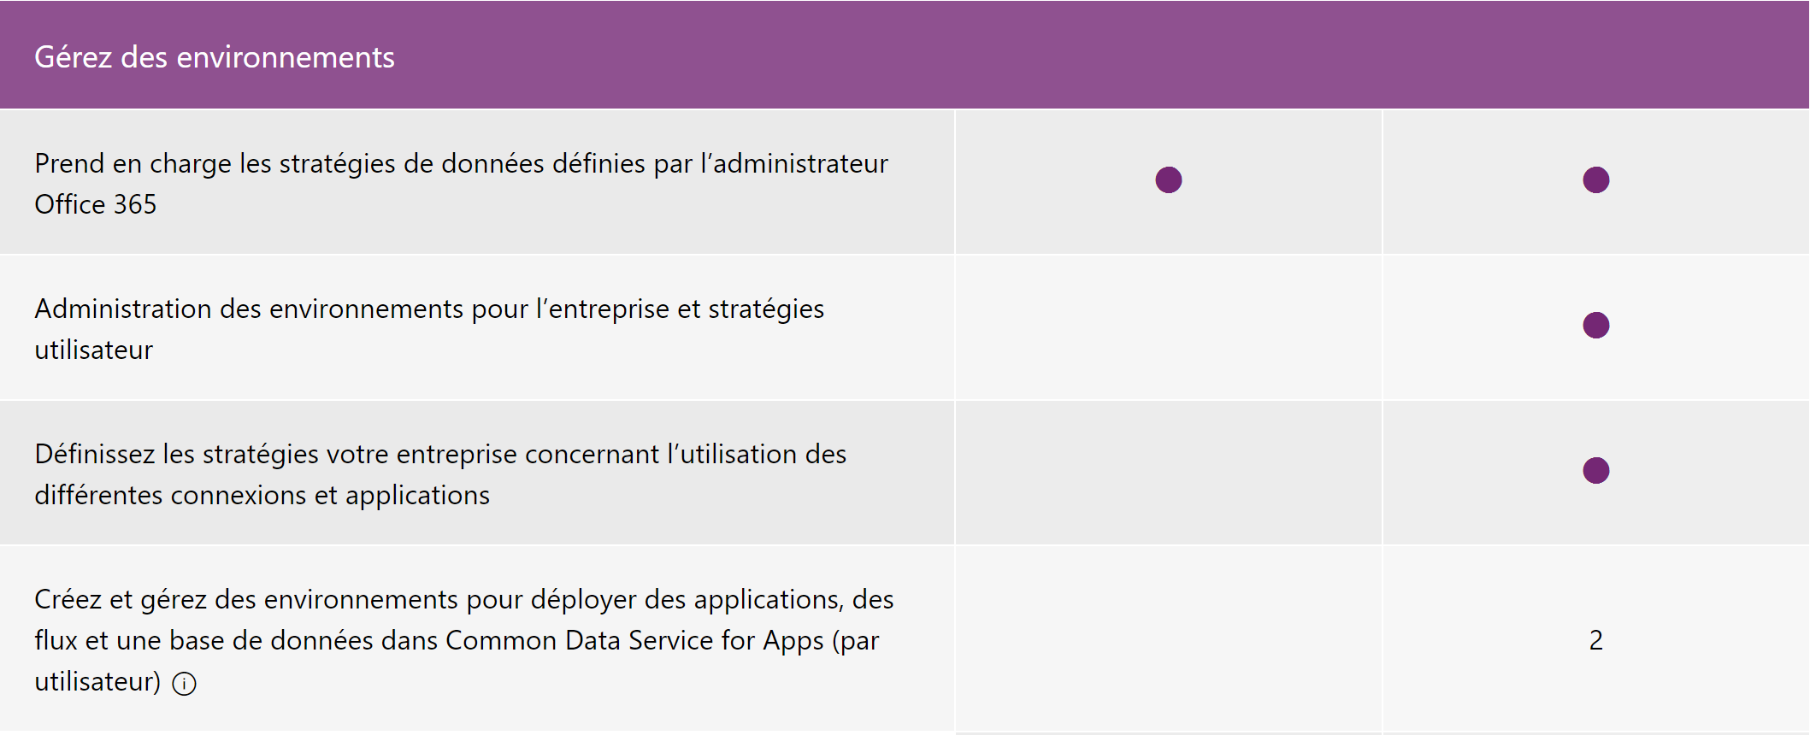
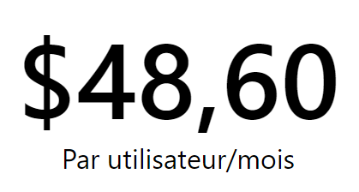
Licences
Source: Microsoft (https://powerapps.microsoft.com/fr-fr/pricing/)

Slide 10

Power?
3 approches différentes du fonctionnement
1. Qui est propriétaire de l’application?
2. Qui forme les utilisateurs?
3. Qui maintient et supporte l’application?
4. A quel moment l’application devient « business critical »?

Slide 11
Gouvernance globale
S’appuyer sur celle de Microsoft 365/Dynamics 365
Définir le ou les comptes de service – Avec Licence P2 et Global Admin
Définir les objectifs
Déterminer la matrice de responsabilité
Maintenir un Glossaire unique et central
Initier la consolidation des normes de nommage
Consolider les logs et mettre en place le reporting
Décrire le processus de livraison

Slide 12
Données locales
Déployer la passerelle avec un compte de service
Qui gère la passerelle de données locales
Qui mesure l’activité de la passerelle
Attention à ne pas créer un étrangement
Toujours travailler en cluster d’au moins 2 nœuds
Dédier les clusters de passerelles

Slide 13
Les 3 axes de la gouvernance
Humain
Process
Technologie

Slide 14
L’humain
Notes:
10mn

Slide 15
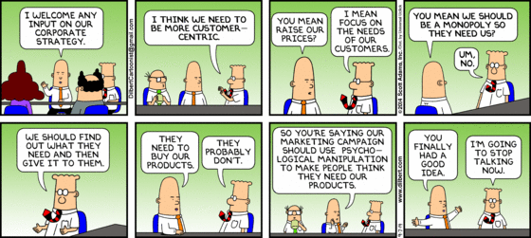
Approche IT Centric
Ou plutôt Customer Centric?

Slide 16
Éduquer les utilisateurs
Définir les persona
Évaluer les compétences par persona
Déterminer les compétences à acquérir
Monter un plan pédagogique
Inclure dans la conduite du changement
Objectif: Réduire la « Friction technologique »
Notes:
Les utilisateurs refuse de comprendre la gouvernance car:
Elle semble trop complexe
Il pensent ne pas comprendre les outils

Slide 17
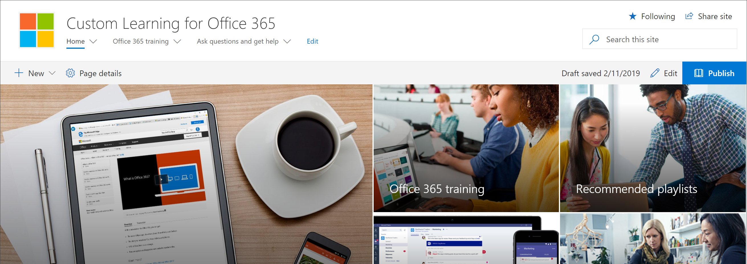
Custom Learning 4 O365
https://docs.microsoft.com/en-us/office365/customlearning/

Slide 18
Keep it simple
Adopter une attitude « Lean »
Ne pas expliquer les outils mais les cas d’usages
Démarrer petit

Slide 19
PowerApps
Notes:
10mn

Slide 20
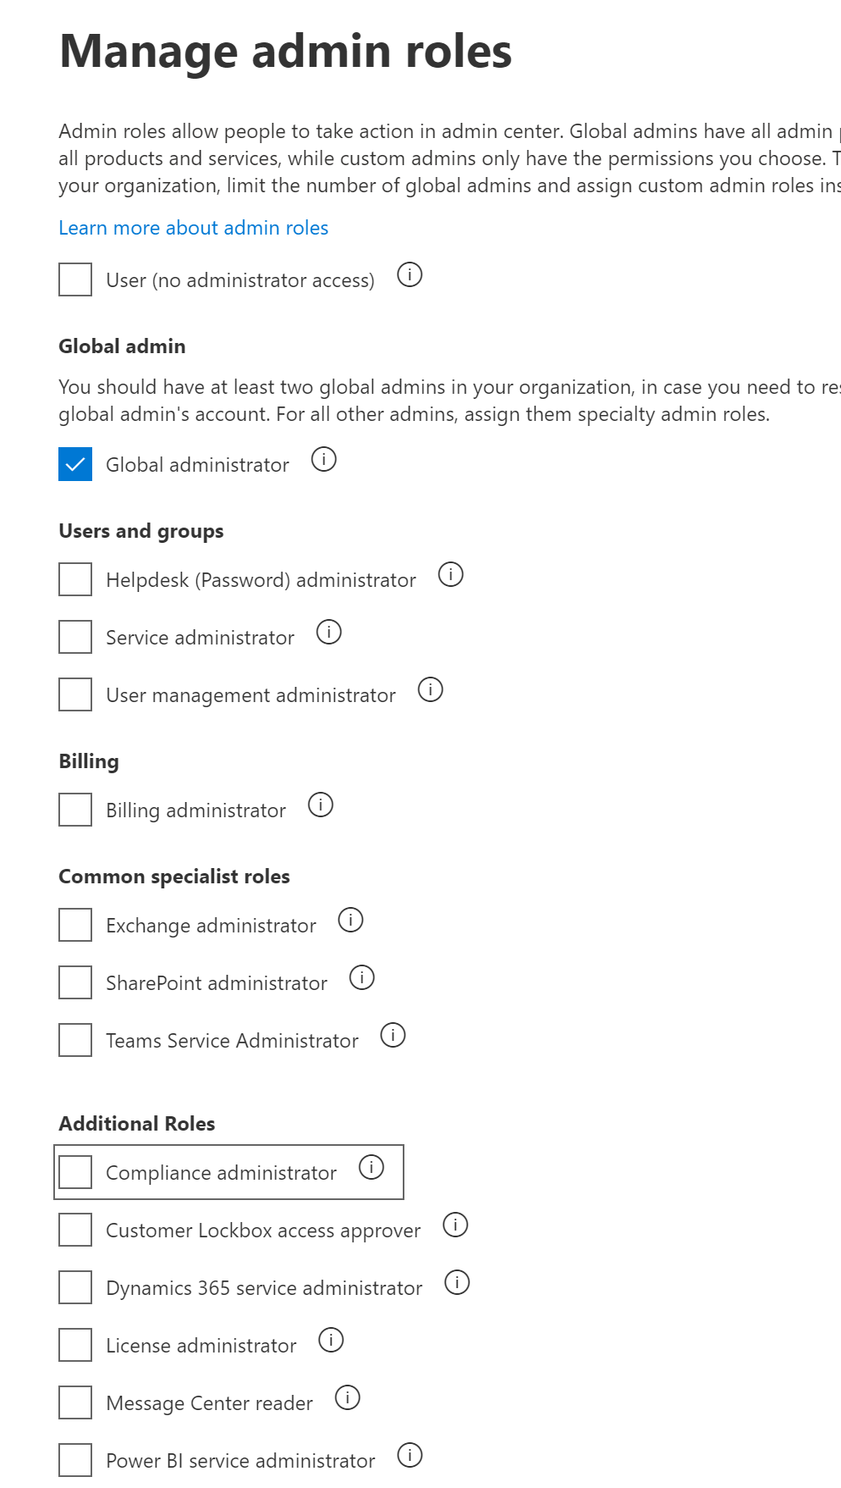
Administration
Pas de rôle d’administrateur
Identifier les applications grâce à P2
Décrire le support L3
Désigner un « Product Owner »
Le compte de service est propriétaire de l’application
Définir les engagements de service
Publier les conventions de nommage

Slide 21
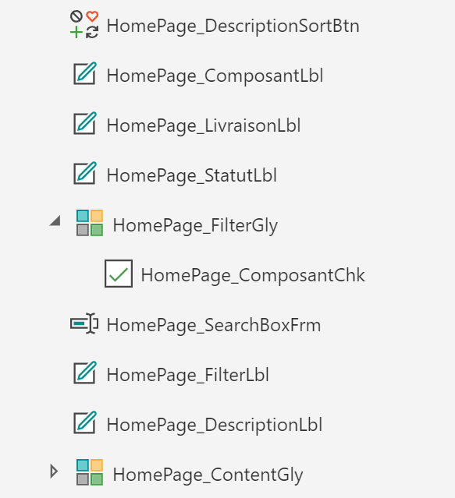
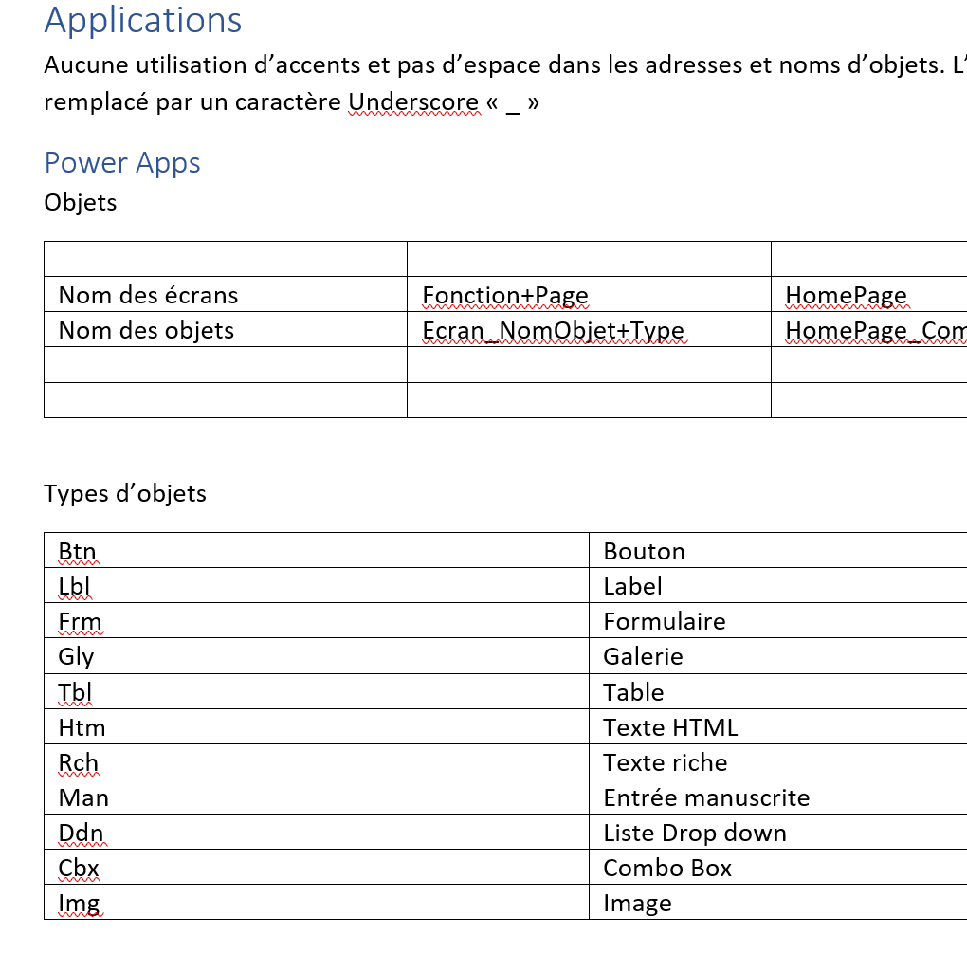

Slide 22
Microsoft Flow
Notes:
10mn

Slide 23
Administration
Pas de rôle d’administrateur
Identifier les flux grâce à P2
Décrire le support L3
Identifier qui est en charge
Définir les engagements de service
Publier les conventions de nommage
Mettre la liste SP comme propriétaire

Slide 24
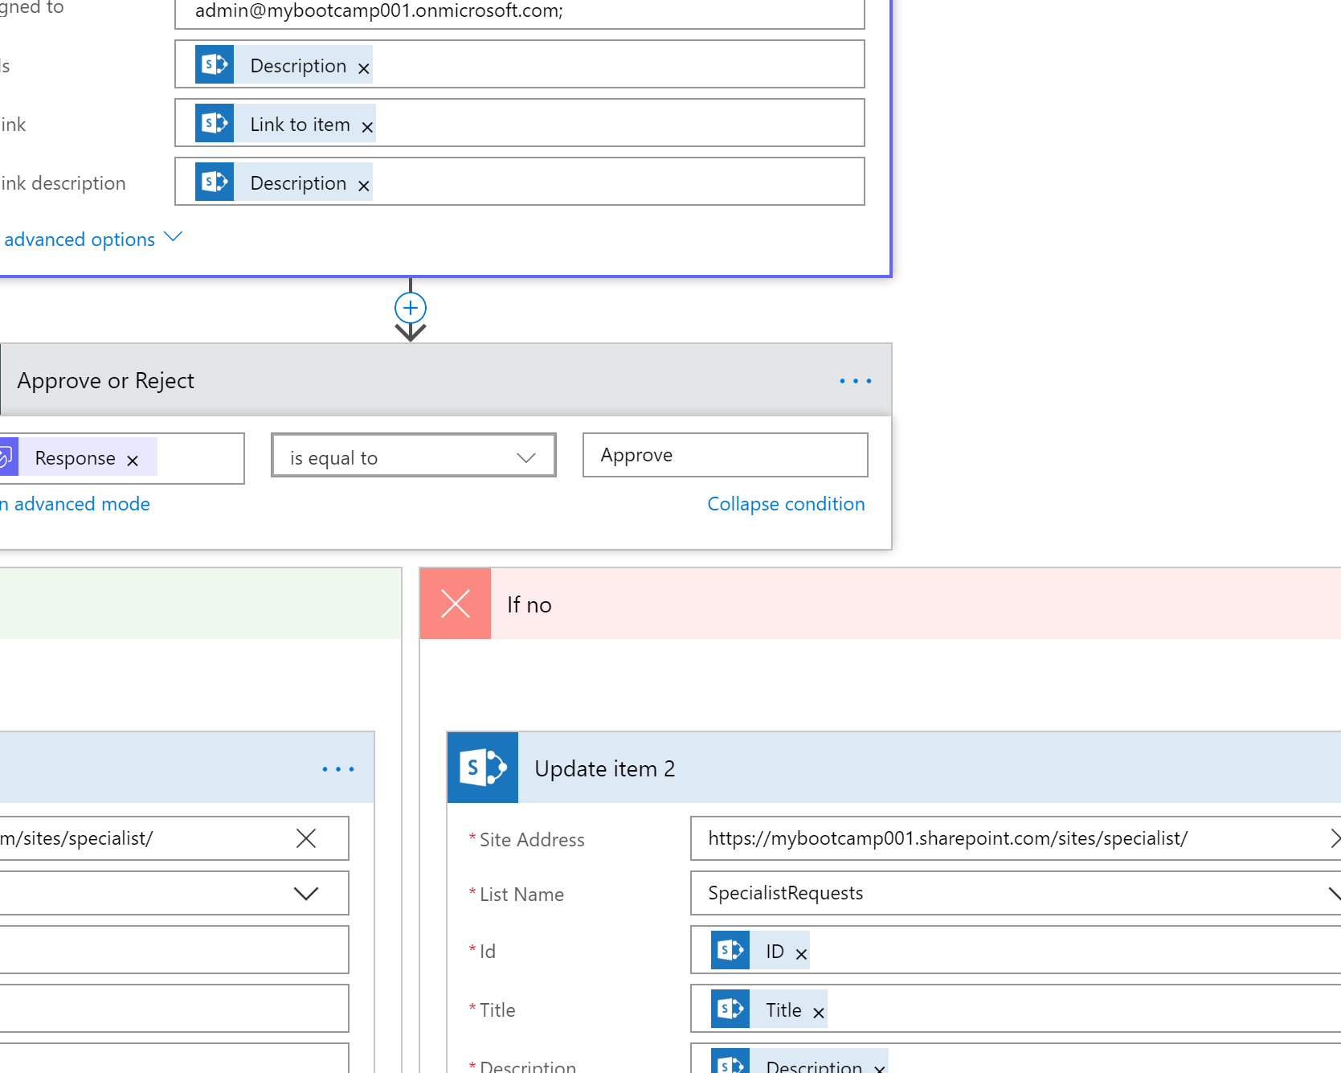
Normalisation des objets et des sources de données
Utilisation de PNPFramework pour le déploiement

Slide 25
Power BI
Notes:
10mn

Slide 26
Donner de la valeur métier aux données est un défi
Les définis communs du décisionnel d’affaires sont :
Vue à 360 degrés
Les données se trouvent souvent dans des endroits disparates et cloisonnés, ce qui rend difficile la vision complète de vos activités
Variétés des sources de donnés
Les données résidant dans les solutions Cloud et les emplacements sur site sont difficiles à accéder et à actualiser en toute sécurité
Les bonnes données, pour les bonnes personnes au bon moment
Des utilisateurs différents ont des besoins différents. Les utilisateurs professionnels ont besoin des dernières données opérationnelles
Notes:
The most common challenges with BI, are that it can be difficult for senior leaders and business users to see a complete picture of the business.
*CLICK*
Managing multiple data sources can also be a challenge, especially with data residing in Line of Business Applications, SaaS solutions and other external locations
*CLICK*
And the key challenge is to make the right data available to the right users at the right time. Mobile business users need the latest operational data at their fingertips, no matter where they are or what device they’re using. Different roles have different needs and access levels, so a one-size-fits all solution doesn’t work.

Slide 27
Pourquoi la gouvernance ?
Anticipez et planifiez le succès du “self-service BI”
Évitez la prolifération incontrôlée des applications de BI
Implémenter des processus
Des processus de gouvernance adéquats
Pour prendre les bonnes decisions technologiques
Pour réduire les risques
Favoriser l’adoption
Notes:
A great way of addressing these challenges is to have a governance strategy in place. When we talk to our customers about BI for everyone, they are a bit cautious about it, because they’ve had experiences of managing uncontrolled proliferation of unsupported BI applications in the past, and this discussion helps us establish the fact that self-service BI success doesn’t happen automatically, it needs to be planned, and this can be done by developing a governance plan that implements processes for data security, governance, auditing and data classification.
And once you have a governance strategy, it can help drive infrastructure and technology decisions, reduce risks, since both business and IT are involved and lead to increased user adoption.

Slide 28
Si vous ne prenez pas de décisions….
Définissez le cadre !
Quelqu'un d'autre le fera pour vous... Et ça ne sûrement pas la meilleure décision!

Slide 29






Considérations importantes
Sécurisation des données téléchargées sur le service
Publier des données sur l'ensemble de l'Organisation
Partager du contenu avec des utilisateurs externes
“Publish to web”
Si vous ne décidez pas en avance, quelqu'un d'autre le fera….plus tard !
“Custom visuals”
Audit des logs
Notes:
The key thing about governance, is that if you don’t make decisions upfront, someone else will make those decisions later, and that may not be the best decision for your organisation.
Here are some examples of decisions that employees end up making if guidance or procedures are not in place:
Power BI service is hosted in the cloud, so it’s really important to provide guidance to employees, on which types of data can, and can’t be uploaded to the service, rather than letting people decide through intuition.
Power BI allows you to share data and reports with the entire organisation, however, if everyone starts doing that, then it’ll be difficult to identify meaningful information
You can also share data with external users via Power BI, however, it’s important to identify scenarios in which your employees would do that, and possibly control who can do this.
Publish to web is an interesting option. It’s a setting that’s on by default, so we’ve had some instances where people have used this option as a workaround for licensing or sharing and not realised that the reports get published to the public internet.
Some of our visuals share data with our partner firms, for example, your use of ArcGIS Maps for Power BI, is subject to Esri’s terms and privacy policy, and the data is shared with ESRI. This may or may not be important to you, but it’s worth knowing and making an informed decision, as the data may leave geographical boundaries when you use a partner service. The same could happen with any other custom visual, so vetting them for use in the organisation is advisable.
Audit logging is a great feature, and can help you backtrack activities to meet compliance requirements, however, you need to turn this feature on, in order to use it, as it’s off by default.
So I hope these examples help you understand that it is important to make governance decisions upfront, as every organisation is different and it’s really important to have a governance strategy that works best for the organisation.

Slide 30
Gérer les oppositions
Besoins utilisateurs
Considérations des TI

Slide 31
Qui impliquer ?
Comité de gestion pour aligner la stratégie
Direction executive pour le support de l’initiative
“Business owners” pour l’alignment fonctionnel et opérationnel
Architecte technique pour la definition de l architecture de la plateforme de données
BI Pros et TI pour la sécurité des donnés, le support et les opérations
“Power Users”, qui vont créer le “contenu” et les workflow
Ce n’est pas “juste” un sujet TI
Notes:
There are a number of areas of the business that should be involved, so they can provide their input into the Governance Strategy.
A Management Review Committee can help to align the strategy to corporate principles and goals
Executive Management can help with aligning it to their future Vision and provide Funding to support this framework.
Business owners can provide strategic insight and direction for building BI solutions in their respective departments or teams.
Architecture Design committees can provide guidance on organizational patterns and best practices for data solutions.
BI Pros and IT can provide input on Security, Hosting, Operations and Support
And ultimately solutions will largely be created by a number of Power Users, who will be responsible for the lifecycle of reporting and the creation of content, so their input can ensure the governance strategy will work for them.

Slide 32
Modèle de gouvernance
TIGHT CONTROLS
EDW*
Permanent record
Subject to compliance
Push down content
Reporting services
BUSINESS UNIT
DASHBOARDS, KPIS & SCORECARDS
Push up content
Power BI Desktop
Excel or other reports
Knowledge management
Information sharing
DEPARTMENTAL, TEAM OR GROUP REPORTING
PROJECT REPORTING
Personal/Private views
Data science exploration
PERSONAL REPORTING
* Enterprise Data Warehouse
LESS CONTROLS
Notes:
When we talk about governance models we also need to consider which solutions require tight controls versus solutions that require less controls.
Your Enterprise Data Warehouse or your Corporate KPIs or Scorecards will likely have tighter controls. They might have regulatory compliance and need to be monitored and audited. That is not something that you are going to release out for anybody to change, because you don’t want individuals to be able to update the data to make their KPIs look better. You wouldn’t want consultants controlling their own consultancy rates for example.
When we start looking at personal or project level reporting you can relax some of the controls and allow the individual teams to make decisions.
The business should have the ability to connect to and mashup data. It might be their own project data or data that someone is investigating. For example a data scientist exploring data in a data lake or a business user visualising an Excel spreadsheet someone has sent them. If you are exploring data or trying to find new patterns you don’t want to have controls in place that limit this discovery.

Slide 33
Power BI Modes de déploiement
Notes:
Power BI is a very flexible set of tools that can be used for data preparation, data modeling, and/or report development activities. We see three primary approaches to delivery of Power BI solutions
Business-Led Self-Service BI: In this scenario, the business users have the most involvement and control. Although some governed data sources certainly may be utilized as part of the overall solution (which is encouraged), there very well may also be non-standard, non-governed data sources involved (such as industry statistics purchased from a third party) which allow for exploration of patterns that can go well beyond the data recorded in the corporate data warehouse. The critical difference here is that the business unit takes ownership and support for this type of solution.
IT-Managed Self-Service BI: In this scenario, business users utilize Power BI as a reporting layer over standardized and governed data sources. In this mode, IT produces and governs a data layer of high quality which adheres to conformed enterprise master data. At the same time, the business owns the reporting layer which may or may not adhere to the same development cycles and governance standards promoted by IT.
Corporate BI: This scenario is frequently referred to as ‘enterprise reporting’ or sometimes ‘canned reporting’ wherein IT has full ownership of the entire solution and releases reports for user consumption.
Each of the above scenarios can be employed concurrently, depending on the particular requirements and user base.

Slide 34



Rafraichissement des données centralisées et plus fréquentes
Plus de limitation du volume des données
Sécurité
Support technique (SLA)
Avantages du transfert de responsabilités à TI
Notes:
There are a number of reasons that may initiate an ownership transfer from business-led to Corporate BI, such as:
Data can be centrally refreshed, often more frequently.
Data size limits are typically no longer a constraint.
Additional security capabilities become available.
The solution can receive formal IT support and fall under existing SLAs.
It can also free up business users to continue exploring new data patterns, while maintaining other Power BI solutions which are not yet production-ready, or an ownership transfer to IT does not make sense from a cost or effort perspective.

Slide 35





Une approche balancée
End Users
Power BI/SharePoint
Analysis
Cubes
Data Warehouse
Existing Data
Power Users
LOB Applications
Data Marts
Files
Power BI/Excel Power Tools
IT Pro
Notes:
We believe that Power BI allows you to have a balanced approach. IT can continue to enhance the corporate warehouse by bringing new sources of data, while continuing to apply due diligence, to ensure that the data is accurate, and at the same time, Business users can access data that hasn’t yet been provisioned in the corporate warehouse directly, and blend it with the data from the corporate warehouse. In due course, IT can apply the due diligence and bring it into the warehouse as well.

Slide 36
Conclusion
Notes:
3mn

Slide 37
Documentez!
« Le citizen developer est quand même un développeur »
Pensez à GitHub et GitLab avec Jekyll.
Le fond importe plus que la forme.
Lean donc pensez simple et efficace

Slide 38
Start small! But Start!

